Slide 1
Growth disorders in children
Dr chamilka jayasinghe
SenioR Lecturer in Paediatrics

Slide 2

Short stature

Slide 3
Height is important
Personal health
Professional health
Social health
Sexual health
Self-confidence
Physical health

Slide 4
Definition
short stature is defined as a standing height more than 2 standard deviations (SDs) below the mean (or below the 2.5 percentile) for sex

Slide 5
The causes of short stature
Can be divided into 4 broad categories:
1.chronic disease (including undernutrition genetic disorders),
2. familial short stature (genetic short stature)
3. constitutional delay of growth and development.
4.Endocrine diseases

Slide 6
Classification of short stature by phenotype
subdivided into proportionate and disproportionate short stature
Disproportionate short stature is further subdivided into
Short-limb dwarfism (includes achondroplasia and other chondrodysplasias)
Short-trunk dwarism (includes spondyloepiphyseal dysplasia, Morquio's, and metatropic dwarfism.)
Short neck conditions- Klippel Fiel syndrome, Turner Syndrome

Slide 7
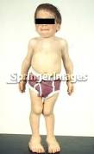
Morquio Syndrome

Slide 8
Normal variant short stature
Familial short stature
Constitutional delay in growth and puberty

Slide 9
The hallmarks of familial short stature
bone age appropriate for chronologic age
normal growth velocity
predicted adult height appropriate to the familial pattern –falls within MPH

Slide 10
Constitutional delay in growth and puberty
delayed bone age
normal growth velocity
predicted adult height appropriate to the familial pattern
a first-degree or second-degree relative with constitutional growth delay (eg, menarche reached when older than 15 y, adult height attained in male relatives when older than 18 y).

Slide 11
PATHOLOGICAL SHORT STATURE
ENDOCRINE
METABOLIC
GENETIC
PSYCHOSOCIAL
SYSTEMIC
NUTRITONAL
IUGR
SKELETAL
IDIOPATHIC

Slide 12
ENDOCRINE CAUSES
GHD/Panhypopit
Diabetes insipidus
Hypothyroidism
Cushing’s
Diabetes mellitus
Hypogonadism

Slide 13
GENETIC SYNDROMES
Turner
Noonan
Russel Silver
Seckel
Down

Slide 14

SYSTEMIC ILLNESSES
Chronic anaemia
CRF
RTA
Asthma
congenital heart disease
Chronic infections
Chronic bowel disease
Steroid therapy

Slide 15
Deprivational short stature
Growth is often impaired in refugees and in children emerging from foster care or orphanages.
The growth pattern with adequate nutrition in a loving environment over time is critical to distinguish pathologic GF from normal variant short stature in such patients.

Slide 16
Evaluation of the child with short stature includes
Documenting the family history
Document pubertal timing in first-degree relatives. i.e
age at onset of menarche for the child's mother and
age of adult height attainment for the father

Slide 17
Systematic review
GI Diarrhea, flatulence suggest malabsorption.
Vomiting can suggest an eating disorder or a CNS disorder (eg, dysgerminoma).
Pain or abdominal discomfort suggests inflammatory bowel disease
Cardiac disease: Signs include peripheral edema, murmurs, and cyanosis.
Chronic infections: Poor wound healing and opportunistic infections are signs of potential immune deficiency.
severe asthma associated with chronic steroid use and cystic fibrosis
Neurologic Visual field deficits often herald pituitary neoplasms.
Vomiting, early morning nausea, polyuria, or polydipsia is often associated with masses of the CNS
Renal Polyuria and polydipsia are important symptoms of hypothalamic and pituitary disorders.
Chronic renal disease is a common cause of growth failure (GF).

Slide 18
Key measurements
The child's weight and length/height
prior growth pattern
The final (or current) heights and weights of parents, siblings, and grandparents.
obtain the original birth records to document length, weight, and occipitofrontal circumference at birth.

Slide 19
Examination
Presence of gastrointestinal, renal, or neurologic signs
Menarchal status –of the older girl.
Documentation of height, weight, body proportion (sitting height, trunk-limb proportion)
Serial documentation of height and weight
Signs of secondary sexual characteristics (Tanner staging)
Dysmorphism

Slide 20
Other examination
thyroid enlargement associated with Hashimoto thyroiditis, the most common cause of acquired hypothyroidism.
Test visual fields for signs of pituitary and hypothalamic tumors, initially by gross confrontation.
Inspect fourth metacarpals, which are shortened in persons with pseudohypoparathyroidism, Ullrich-Turner syndrome.
Inspect mucous membranes for ulcerative stomatitis, and Rectal tags and clubbing are also typical in individuals with Crohn disease.
Associated anomalies of midline structures, such as the pituitary gland, are common in patients with major midline facial anomalies.
Growth hormone deficiency (GHD) or panhypopituitarism should be considered as a cause of short stature in such patients

Slide 21
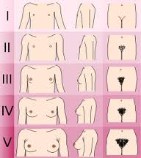
Tanner staging

Slide 22
Mid parental height range
measure each parent’s height in the clinic for optimal calculation of the mid-parental target height, according to one of several formulas,
Target height in cm for a girl = [mother's height in cm + (father's height in cm - 13)]/2
Target height in cm for a boy = [(mother's height in cm + 13) + father's height in cm)]/2
Range +/_ 10 cm

Slide 23
Measuring stature
accurate and reliable height assessment
Measure standing height using a calibrated wall-mounted stadiometer.( Harpendens)
In infants, length is determined using a tabletop recumbent stadiometer.(infantometer)
In children who cannot completely stand or recline (eg, those with spina bifida, those with contractures), arm span measurement

Slide 24
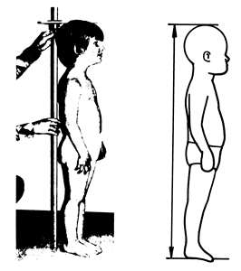

Slide 25
Measuring stature
Stadiometer
Barefeet
Four points touching the wall
Frankfurt plane [line joining inferior orbital margin to ext auditory meatus] parallel to ground
Serial measurements better

Slide 26
Measure of arm span
provides a reliable alternative for longitudinal assessment of long bone growth.
Ascertain arm span by facing the child against a flat firm surface (usually the wall), fully extending the arms, and measuring the maximal distance between the tips of the middle fingers.
If this positioning is physically impossible, a flexible tape measure may be rolled along the dorsal aspect of the arms and upper back to determine arm span.

Slide 27
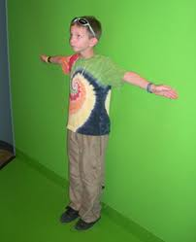

Slide 28
Growth patterns
Growth velocity charts
Growth is not a steady continuous process but occurs in episodic increments

Slide 29
Height velocity
Documenting height velocity over time
Calculate height velocity as the change in standing height over at least 6 months (in children) or in length over at least 4 months (in infants).
Poor linear growth is defined as linear growth velocity more than 2 SDs below the mean for gender, genetic composition, and chronologic age.

Slide 30
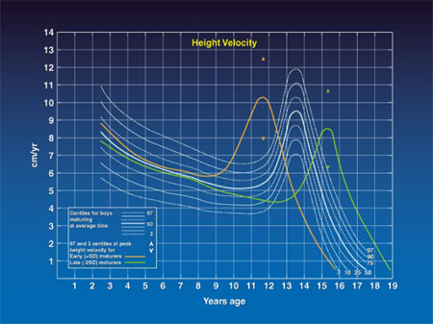
Height velocity chart

Slide 31
Growth velocity
year | Increment in cm
1 | 25
2 | 10
3, 4 | 7
5, 6 | 6
7 - puberty | 5
mid-puberty | 9 – 10.3

Slide 32
The normal difference in body proportion with age
The infant's head is proportionally much larger than the adult's, and the limbs are shorter.
At birth the ratio of upper segment to lower segment is about 1.7:1
at age 3 to 1.3:1
At age 7 to 1:1

Slide 33
Assessment of upper segment: lower segment ratio
In patients in whom short-limb dwarfism is suspected
the sitting height obtained by measuring the upper body segment, or crown to pelvis, as the child sits upright on a platform-mounted stadiometer (or on the floor with a wall-mounted stadiometer).
the lower segment can be determined by measuring from the superior midline brim of the symphysis pubis to the floor, with the child standing (feet placed together).

Slide 34
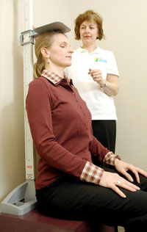

Slide 35
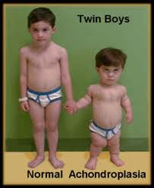

Slide 36
Routine laboratory investigations
FBC, urinalysis, glucose, creatinine, and alkaline phosphatase.
ESR
Radiographs should include a hand & wrist for bone age in the proportionate group, and a lateral of the spine, neck and skull, and an additional anteroposterior view of the pelvis in the disproportionate group

Slide 37
Other useful tests include the following
Thyroid function tests
Karyotype The 45,X Ullrich-Turner syndrome
Anti endomysial immunoglobulin A (IgA) and immunoglobulin G (IgG), transglutaminase IgG, and antigliadin IgG titers for coeliac disease (gluten enteropathy)
Sweat chloride testing to exclude cystic fibrosis (CF):

Slide 38
Imaging Studies
Perform anteroposterior radiography of left hand and wrist to assess bone age
renal and cardiac ultrasonography in all patients with Ullrich-Turner syndrome. The most commonly associated anomalies include horseshoe kidney and bicuspid aortic valve.
neuroimaging

Slide 39
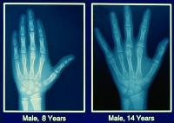

Slide 40
Treatment
Treatment of specific cause
GH deficiency- recombinant growth hormone therapy
Androgen replacement
Thyroxine replacement

Slide 41
GHD: PHYSICAL FEATURES
Cherubic face; fair complexion
Normal IQ
Frontal bossing
Midfacial crowding
Pallor
Micropenis
Truncal obesity

Slide 42
GHD: PROVOCATIVE TESTS
Needed because normal range is wide
Basal GH of no help
Insulin tolerance test is gold standard
Exercise test
Sleep test
Clonidine stimulation test: 0.15 mg/m2 clonidine given orally in morning
IV line must be in place
Sample for GH at 0’, 30’, 60’ and 90’
GH must rise to > 10 ng/ml
Value of > 7 ng/ml indicates partial deficiency

Slide 43
Other specific tests
Measurement of serum levels of insulin like growth factor-I (IGF-I) and IGF binding protein-3 (IGFBP-3) These are useful tests for growth hormone deficiency (GHD)

Slide 44
serum levels of GH
Beyond the first months of life, endogenous GH is secreted in a pulsatile fashion.
These intermittent peaks are greatest after exercise, after meals (as blood glucose levels decrease), and during deep sleep.
Therefore, measuring a single random serum GH value is of no use in the evaluation of the short child
Although a random serum GH value of more than 10 mg/dL generally excludes GHD, a random low serum GH concentration does not confirm the diagnosis of GHD

Slide 45
Growth hormone therapy
EVOLUTION:
1958 - pituitary GH
1978 - Creutzfeld- Jacob disease
1985 - approval for biosynthetic hGH

Slide 46
Growth hormone therapy
Available only as injection
Subcutaneous
Administer after 8.00 pm
3 to 7 times a week
0.15 to 0.3 mg/kg/week
Effect is dose-dependent

Slide 47
Growth hormone therapy
Response better if started earlier
Average increment = 10 cm/year
Better response in classic GHD
Higher dose needed in Turner syndrome

Slide 48
Specific reference data is available
for standing height, head circumference, and weight , for males and females
for most developed countries
most ethnic subpopulations (including Asians and blacks)
common genetic disorders e.g, Down syndrome, Ullrich-Turner syndrome, achondroplasia.

Slide 49
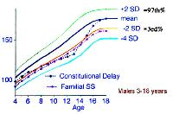

Slide 50
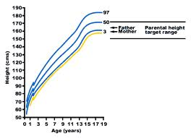

Slide 51
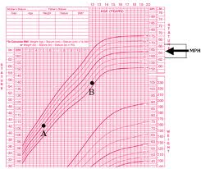

Slide 52
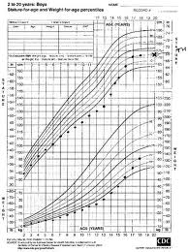

Slide 53
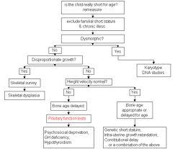

Slide 54
THE END

